Slide 1
1st Individual Meeting-Group5
Hardware Component Selection and Ordering
Instructor: Prof. Mike Aleshams
Submitted by
Soumya Thazhathu Panchickal
(C0753009)

Slide 2
Gesture Keyboard- Typing letters by moving in the air with machine learning using Beaglebone Black
The aim of this project is to type letters in the air using hand gestures, where the gestures are sensed by a gyroscope and finally displayed on an LCD display.
The main components used are Beaglebone black,Arduino board, Gyroscope and LCD display.
The machine learning algorithm "Supervised learning" is used with some predictions along with designed project to detect the alphabet. The gyroscope is attached to hand, so when letters are written in air, the data is transferred to the beaglebone black via arduino,where the data is compared with machine algorithm predictions and then, they are displayed.

Slide 3
Final hardware components for Gesture Keyboard
Beaglebone black
Arduino UNO
Gyroscope sensor(MPU 6050)
RF transmitter-receiver
Voltage regulator(LM2596)
Wifi module(ESP8266)
16x2 LCD display
Power supply
PCB board
Soldering gun and digital multimeter
Bread board, Jumper wires

Slide 4
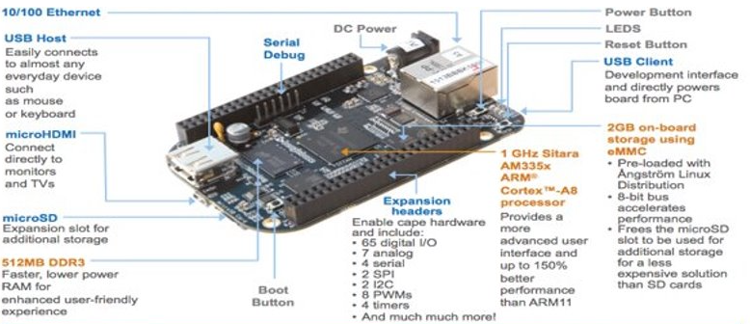
Beaglebone Black
BeagleBone Black is a low-cost, community-supported development platform for developers and hobbyists.

Slide 5
Processor: AM335x 1GHz ARM Cortex-A8
512MB DDR3 RAM
4GB 8-bit eMMC on-board flash storage
3D graphics accelerator
NEON floating-point accelerator
2x PRU 32-bit microcontrollers
Connectivity
USB client for power & communications
USB host
Ethernet
HDMI
2x 46 pin headers
Software Compatibility
Debian
Android
Ubuntu
Cloud9 IDE on Node

Slide 6
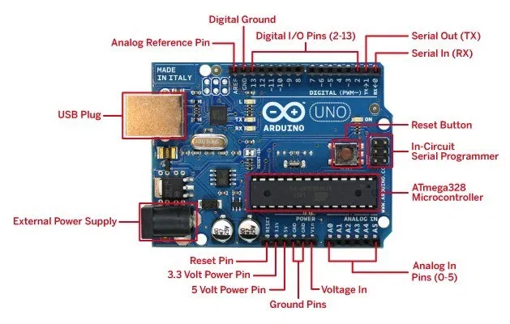
2. Arduino UNO

Slide 7
The Arduino UNO is the best board to get started with electronics and coding.
Specifications:
Microcontroller : ATmega328P
Operating voltage : 5V
Input voltage : 7-12V
Digital I/O pins : 14
PWM Digital I/O Pins : 6
Analog Input Pins : 6
DC current per I/O pin : 20 mA
DC current for 3.3V pin : 50mA
Flash memory : 32 KB (ATmega328P) of which 0.5 KB used by bootloader
SRAM : 2 KB (ATmega328P)
EEPROM : 1 KB (ATmega328P)
Clock speed : 16 MHz

Slide 8
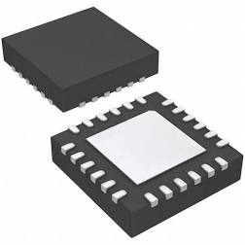
3. Gyroscope Sensor MPU6050
Gyroscope sensor is a device that can measure and maintain the orientation and angular velocity of an object.
These are more advanced than accelerometers.
These can measure the tilt and lateral orientation of the object whereas accelerometer can only measure the linear motion.

Slide 9
Specifications
Three-axis gyroscope and three-axis accelerometer
Power Supply: 4.3 to 9 V
Communication Modes: standard IIC (I2C) communications protocol
Chip built-in 16bit ADC converter, 16-bit data output
Gyroscope Range: +/-250, +/-500, +/-1000, +/-2000 °/s
Acceleration Range: +/-2g, +/-4g, +/-8g, +/-16g

Slide 10
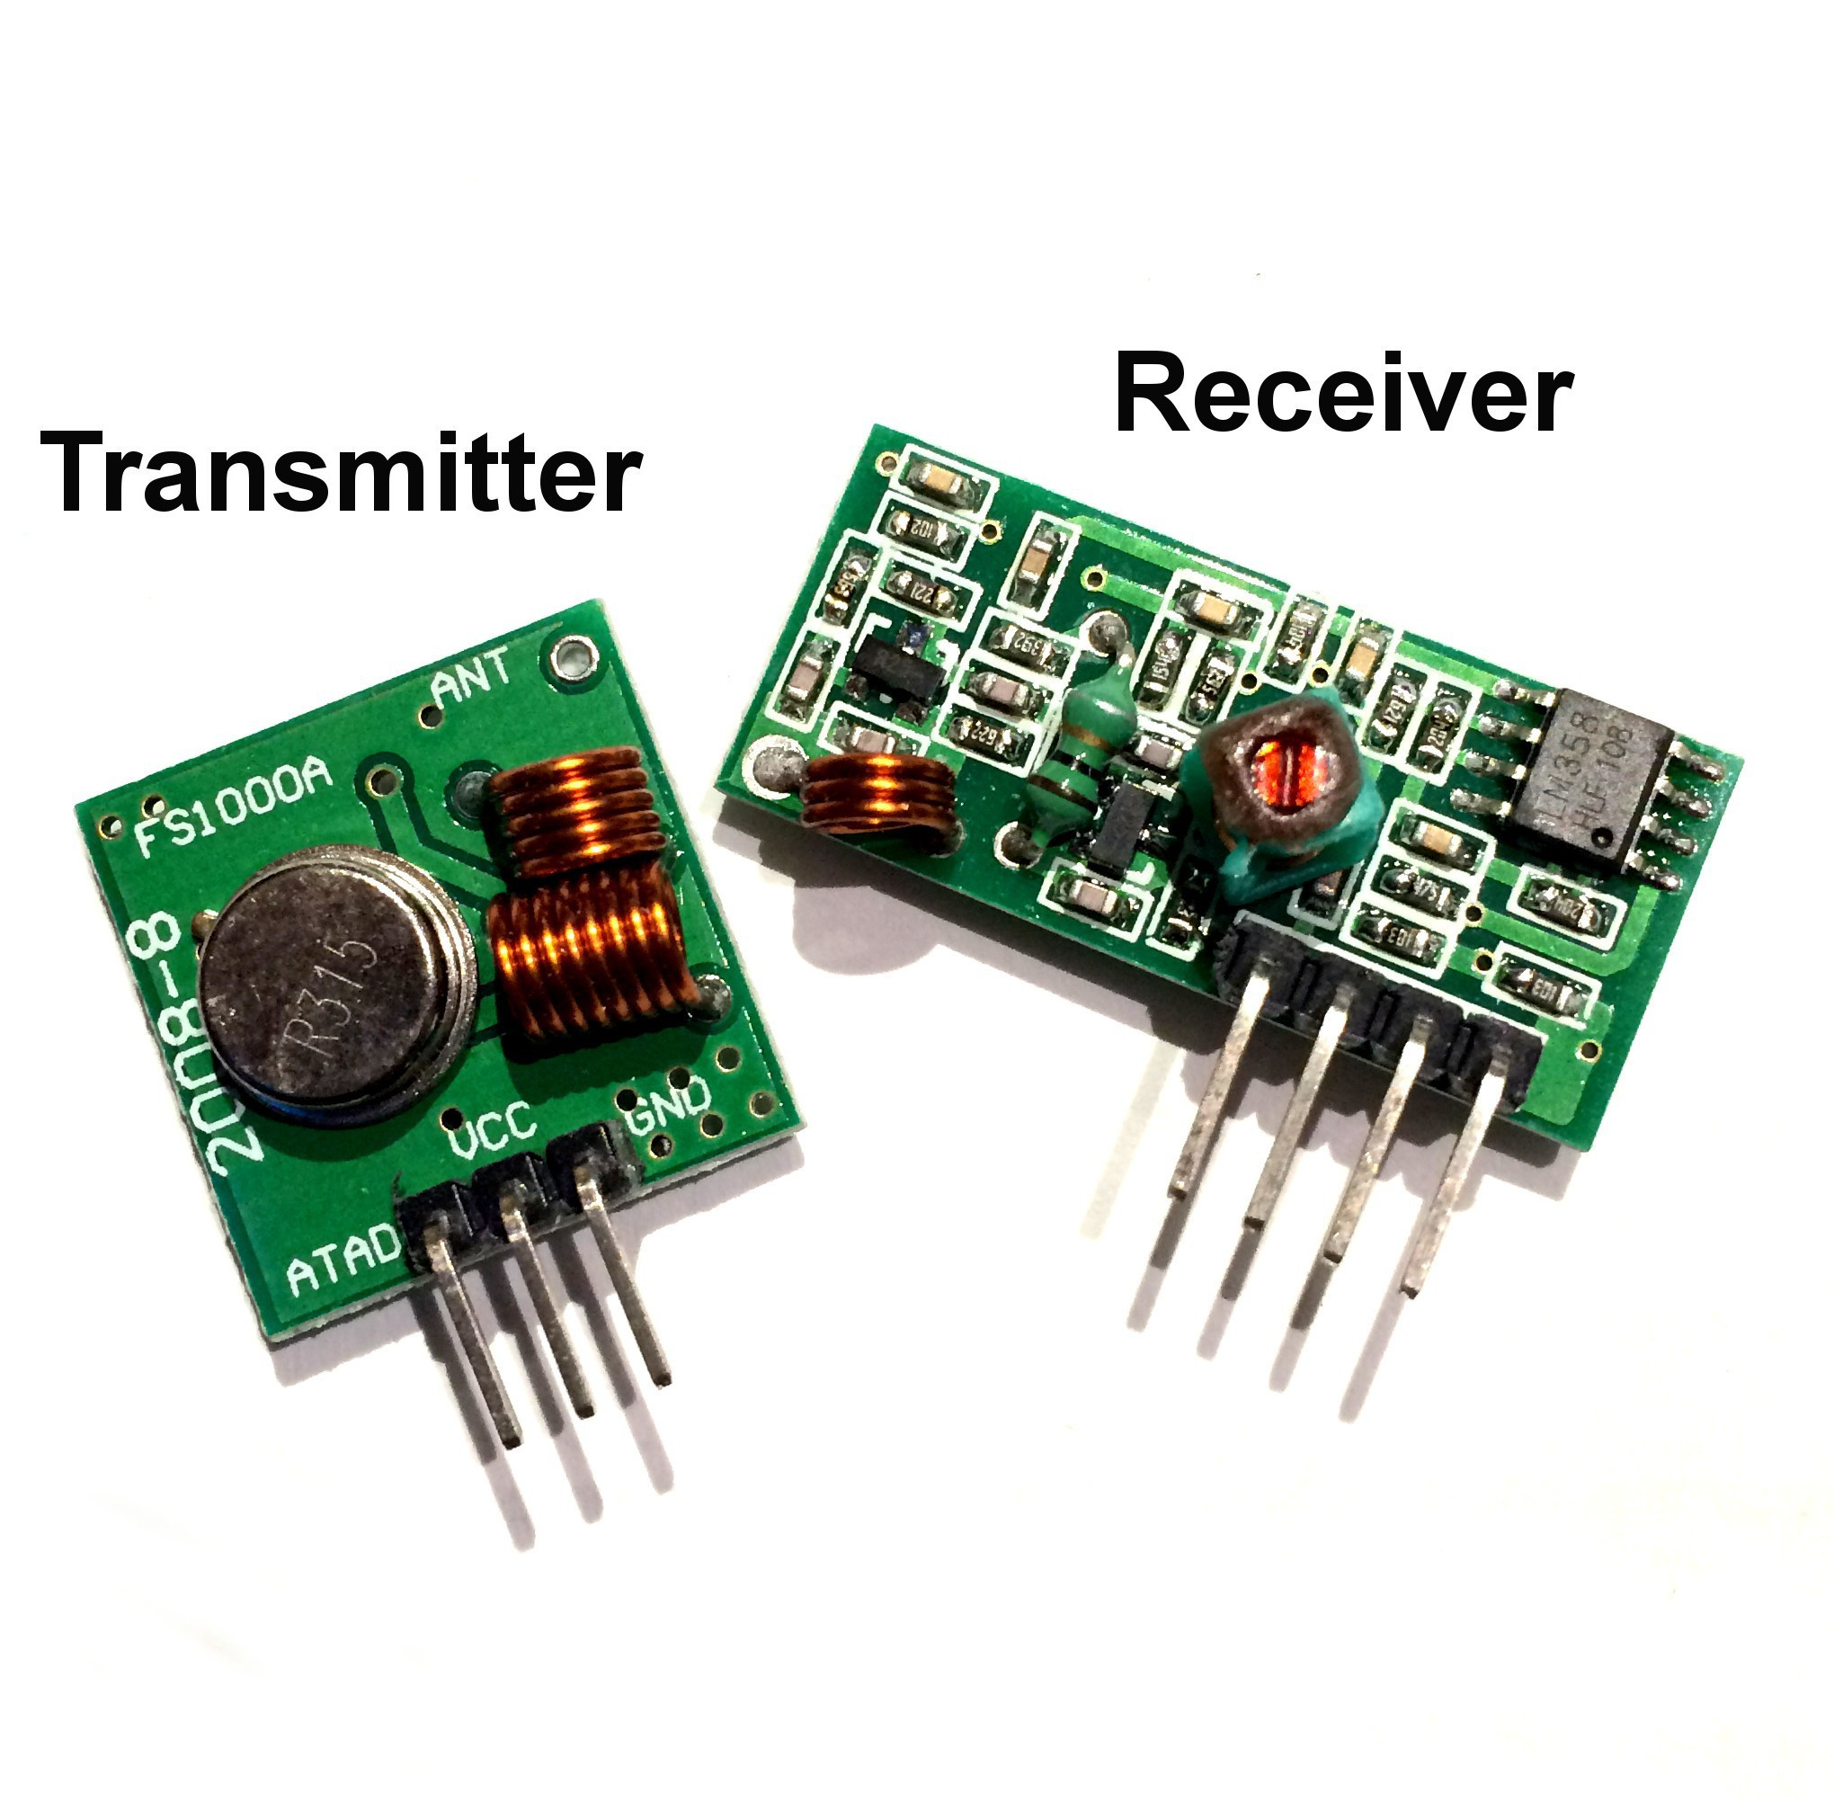
4. RF 433MHz Transmitter-Receiver
Receiver frequency: 433MHz.
Receiver typical sensitivity: 105Dbm.
Receiver current supply: 3.5mA.
Receiver operating voltage: 5V.
Low power consumption.
Transmitter frequency range: 433.92MHz.
Transmitter supply voltage: 3V~6V.
Transmitter output power: 4~12Dbm.

Slide 11
5. Voltage Regulator LM2596
The LM2596 regulator is monolithic integrated circuit ideally suited for easy and convenient design of a step−down switching regulator
Specifications
Adjustable Output Voltage Range 1.23 V − 37 V
• Guaranteed 3.0 A Output Load Current
• Wide Input Voltage Range up to 40 V
• 150 kHz Fixed Frequency Internal Oscillator

Slide 12
The other features include :
Guaranteed 4% tolerance on output voltage within specified input voltages and output load conditions, and 15% on the oscillator frequency.
External shutdown is included, featuring 80 A (typical) standby current.
Self protection features include switch cycle−by−cycle current limit for the output switch
Thermal shutdown for complete protection under fault conditions.

Slide 13
6. ESP8266 Wi-Fi Module
Specifications
It employs a 32-bit RISC CPU based on the Tensilica Xtensa
It has a 64 KB boot ROM, 64 KB instruction RAM, and 96 KB data RAM.
External flash memory can be accessed through SPI.
2.4 GHz Wi-Fi (802.11 b/g/n, supporting WPA/WPA2).
General-purpose input/output (16 GPIO).
Inter-Integrated Circuit (I²C) serial communication protocol.
Analog-to-digital conversion (10-bit ADC).
Serial Peripheral Interface (SPI) serial communication protocol.
I²S (Inter-IC Sound) interfaces with DMA(Direct Memory Access) (sharing pins with GPIO).
UART (on dedicated pins, plus a transmit-only UART can be enabled on GPIO2).
Pulse-width modulation (PWM).

Slide 14
7. 16X2 LCD Display
Specifications
Operating Voltage is 4.7V to 5.3V
Current consumption is 1mA without backlight
Alphanumeric LCD display module, meaning can display alphabets and numbers
Consists of two rows and each row can print 16 characters.
Each character is build by a 5×8 pixel box
Can work on both 8-bit and 4-bit mode
It can also display any custom generated characters
Available in Green and Blue Backlight

Slide 15
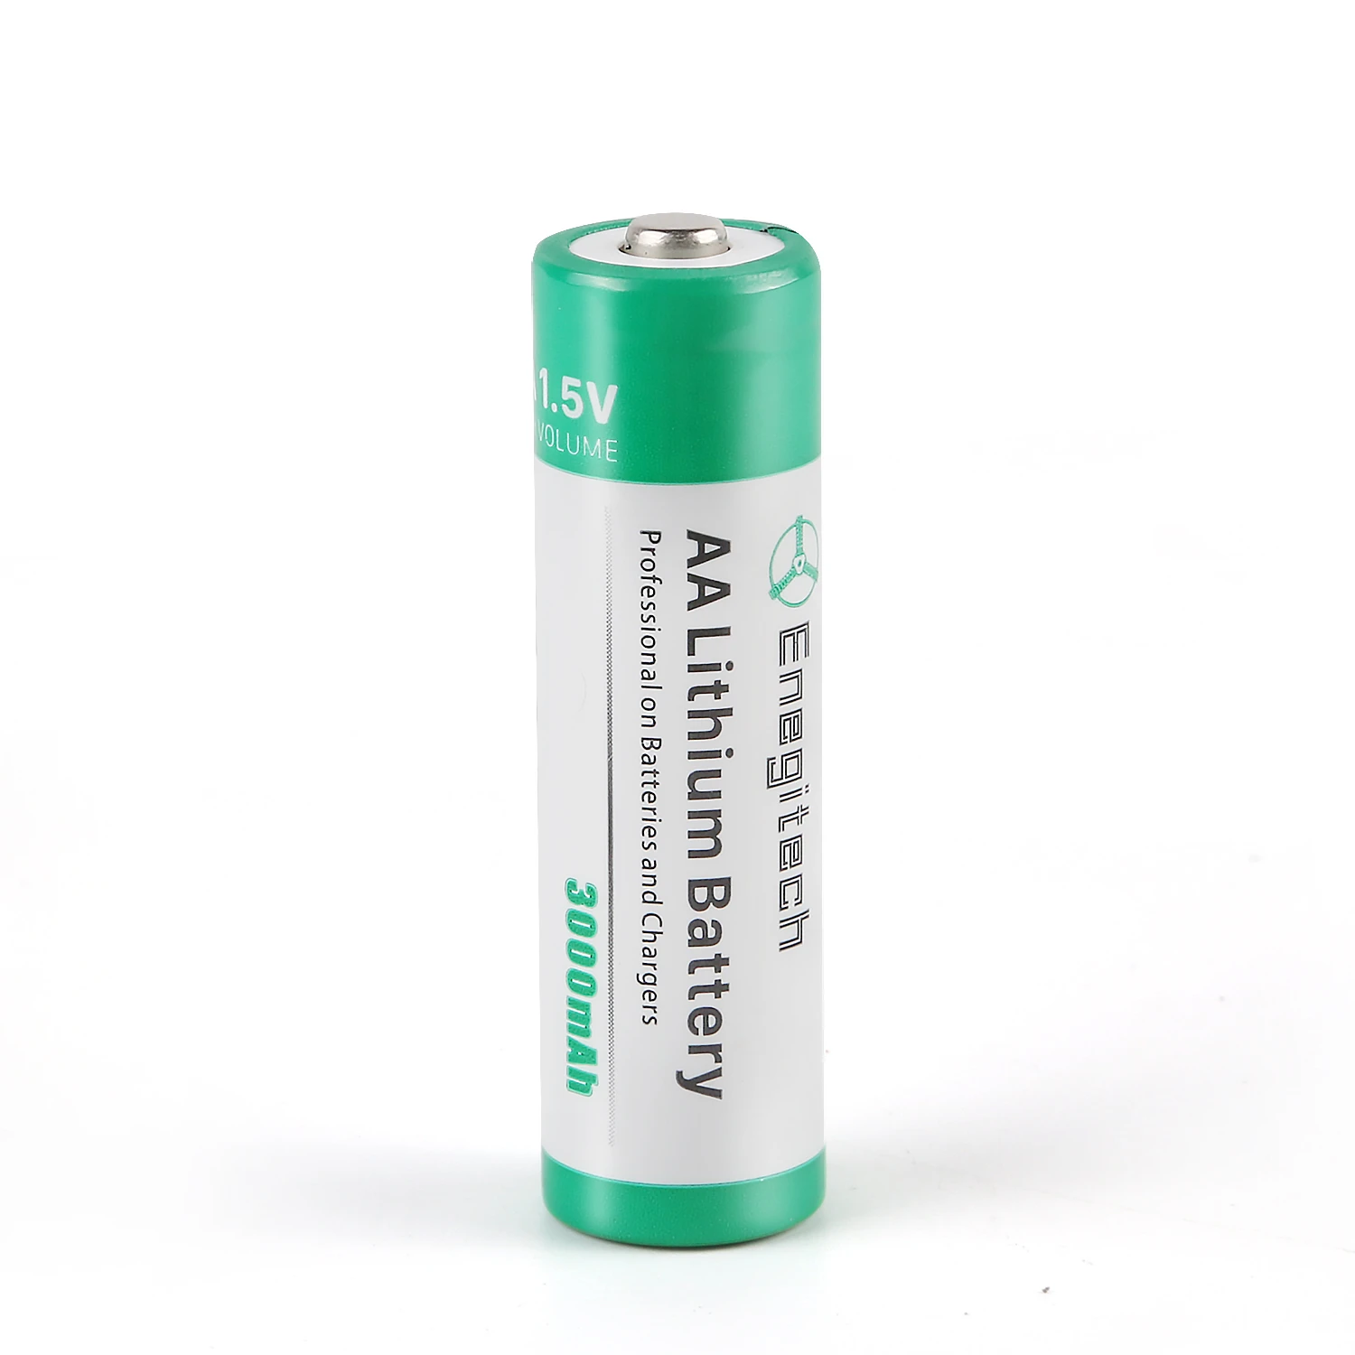
8. Power Supply
Lithium ion battery is used as power supply
The nominal voltage of lithium-ion is 3.60V/cell
1.5Vx8 lithium ion battery is used in our project
A reading of 1.3 to 1.5 volts means the battery is good.
A brand new battery might show a higher voltage level.

Slide 16
9. PCB Board
A printed circuit board, or PCB, is used to mechanically support and electrically connect electronic components using conductive pathways, tracks or signal traces etched from copper sheets laminated onto a non-conductive substrate.
A raw circuit board has two layers, the bottom being non-conductive, and the top being a sheet of metal such as copper.
The board is made up of material that does not conduct electricity, usually fiberglass. Normally copper is etched (set in thin lines) inside the board between the layers of fiberglass, or on the surface of the board. Electronic components are then attached to this board using a metal to conduct electricity.

Slide 17
10. Soldering Gun and Digital Multimeter
A soldering iron is a hand tool used to heat solder, usually from an electrical supply at high temperatures above the melting point of the metal alloy.
This soldering tool is made up of an insulated handle and a heated pointed metal iron tip
To maintain cleanliness, a user will hold the soldering iron and use a wet sponge to clean the soldering iron tip prior to soldering components
Digital multimeters combine the testing capabilities of single-task meters—the voltmeter (for measuring volts), ammeter (amps) and ohmmeter (ohms)
The face of a digital multimeter typically includes four components:
Display: Where measurement readouts can be viewed.
Buttons: For selecting various functions; the options vary by model.
Dial (or rotary switch): For selecting primary measurement values (volts, amps, ohms).
Input jacks: Where test leads are inserted.

Slide 18
11. Bread Board, Jumper wires
A breadboard is a solderless device for temporary prototype with electronics and test circuit designs.
Most electronic components in electronic circuits can be interconnected by inserting their leads or terminals into the holes and then making connections through wires where appropriate.
The breadboard has strips of metal underneath the board and connect the holes on the top of the board.
Jumper wires are simply wires that have connector pins at each end, allowing them to be used to connect two points to each other without soldering.
Jumper wires are typically used with breadboards and other prototyping tools in order to make it easy to change a circuit as needed

Slide 19
References
Beagleboard(n.d). What is Beaglebone black. Retrieved October 14,2020, from https://beagleboard.org/black
Store(n.d). Arduino UNO Rev3. Retrieved October 14,2020, from https://store.arduino.cc/usa/arduino-uno-rev3
Addicore(n.d). MPU6050 3-Axis Gyroscope and Accelerometer. Retrieved October 14,2020, from https://www.addicore.com/GY-521-MPU6050-p/170.htm
TDK invensense(n.d). MPU6050 3-Axis. Retrieved October 14,2020, from https://invensense.tdk.com/products/motion-tracking/6-axis/mpu-6050/
Elprocus(n.d). RF module transmitter receiver. Retrieved October 14,2020, from
https://www.elprocus.com/rf-module-transmitter-receiver/
Techzeero(n.d). ESP8266 wifi module. Retrieved October 14,2020, from https://techzeero.com/sensors-modules/esp8266-wifi-module
Components101(n.d). 16X2 LCD pinout. Retrieved October 14,2020, from https://components101.com/16x2-lcd-pinout-datasheet

Slide 20
Claypower(n.d). Lithium ion battery. Retrieved October 14,2020, from https://www.claytonpower.com/products/lithium-ion-batteries/specifications/
Twi-global(n.d). What is soldering. Retrieved October 14,2020, from https://www.twi-global.com/technical-knowledge/faqs/what-is-soldering#HowitWorks
Fluke(n.d). What is a digital multimeter. Retrieved October 14,2020, from https://www.fluke.com/en-ca/learn/best-practices/measurement-basics/electricity/what-is-a-digital-multimeter
Medium(2019, march 11). General purpose PCB.Retrieved October 14,2020, from https://medium.com/@Graylogix/general-purpose-pcbs-f5ca0f09e99e
Wiring(n.d). What is a breadboard. Retrieved October 14,2020, from http://wiring.org.co/learning/tutorials/breadboard/
Hemmings.M(2018, January 30). What is a jumper wire.Retrieved October 14,2020, from http://blog.sparkfuneducation.com/what-is-jumper-wire

